Slide 1
Software as a Service(SaaS) in Cloud Computing
J.SRIDHARAN-2014503056

Slide 2
Software as a Service
Software as a service (or SaaS) is a way of delivering applications over the Internet as a service. Instead of installing and maintaining software, you simply access it via the Internet, freeing yourself from complex software and hardware management.
Advantages of SaaS :
SaaS customers have no hardware or software to buy, install, maintain, or update.
Access to applications is easy: You just need an Internet connection.
The provider manages access to the application, including security, availability, and performance.

Slide 3
Secure Shell (SSH)
Secure Shell is a cryptographic network protocol for operating network services securely over an unsecured network.
Uses of SSH :
For login to a shell on a remote host.
For executing a single command on a remote host.
For setting up automatic (password less) login to a remote server
Secure file transfer (SFTP)

Slide 4
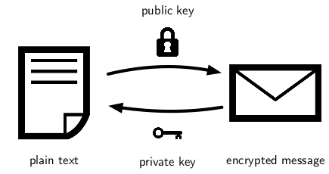
Understanding Secure Shell
Client sends Server request with ID of the key pair.
Server searches for authorized_keys directory.
If found server encrypts a number using public key.
If client has private key decrypts the number.
Finds MD5 hash value and then sends it to server.
Server finds the number and establishes connection.
Server and Client form a shared key using public and private key.
That key will be used throughout the session.
Once session is closed everything is repeated from first.

Slide 5
Aim and Benefits of the project
Aim :
Allow users to access software's from server using SSH session.
Provide information about session details to the user.
Benefits :
Users need not install any software.
Need not care about hardware requirements for a software.
Everyone can have access to wide variety of software's.
No fear of security issues.
Work from anywhere around the globe with any software.

Slide 6
Start
Login
Request Software
Flow Chart Diagram
Provide Software
Close Session
End

Slide 7
Implementation Details
A Graphical User Interface(GUI) will be provided to the user through which he can login to the server. (JAVA Swing)
Login is done using SSH.
After successful login, he/she can see the list of applications. They can select any one of the application and start the session.
Once session is started requested application is started as a new process in the server.
All X11 packets are passed from server to client through SSH session in order to maintain security.
After finishing the work, session can be closed. Once session is closed, process will be terminated properly in the server.
Session details will be displayed to the user.
Now user can start a new session.
All functions will be implemented in Java in order to support cross platform.

Slide 8
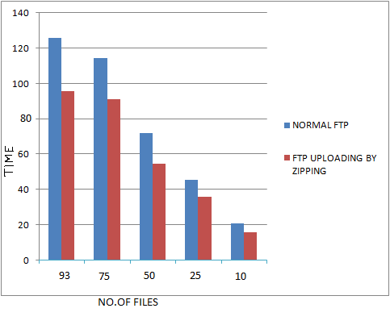
Metrics
No one without private key can establish connection with server.
Fast transmission of data.

Slide 9

Thank You
Software as a Service(SaaS) in Cloud Computing
J.SRIDHARAN-2014503056

